Slide 1
Star Notes

Slide 2
Star Systems…
Groups of two or more stars in the same solar system.
Binary Star systems have two stars.
These appear to be very common in our galaxy.

Slide 3
Galaxy Notes
A galaxy is a massive, gravitationally bound system consisting of: stars, stellar remnants, gas and dust, and dark matter.
Dark matter is an important but poorly understood object in astronomy.
The word galaxy is derived from the Greek galaxias (γαλαξίας), literally "milky", a reference to the Milky Way.

Slide 4
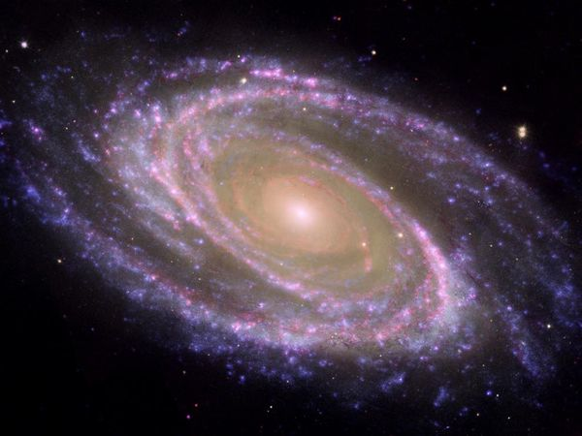
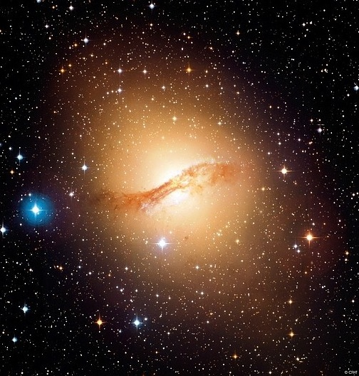
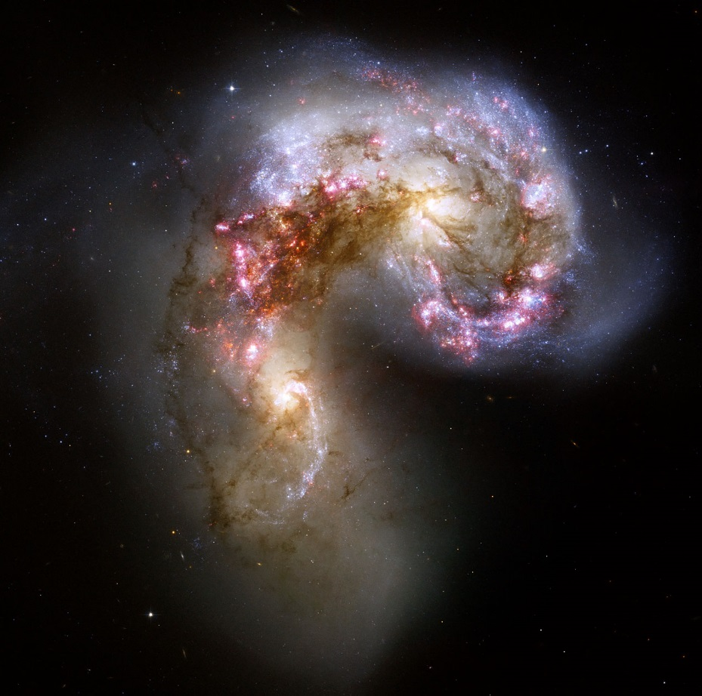
Types of Galaxies

Slide 5
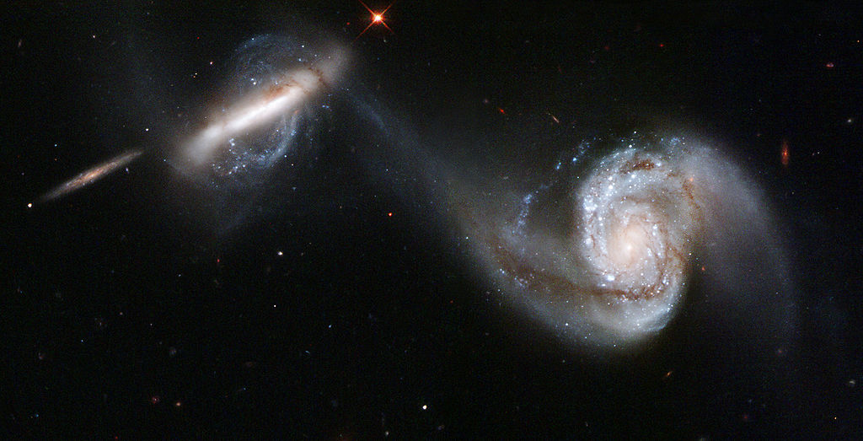

Slide 6
(Hubble Deep Space Picture)

Slide 7
Do black holes exist?
A black hole is a region of space from which gravity prevents anything, including light, from escaping.
We can only observe the gravity effects from Black Holes.

Slide 8
Mr. Garbini’s galaxy(s)
http://www.calvin.edu/academic/phys/observatory/images/Astr212.Spring2011/

Slide 9
Expanding Universe
All galaxies are moving away from each other at a measured rate.
This implies that at one point, all galaxies were closer to each other…

Slide 10
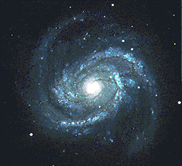
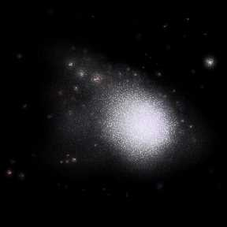
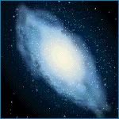
A.
Spiral
B.
Elliptical
C.
Irregular
Make a flip chart for each of the three galaxy types in your notebook.
(Page 119-120)

