Slide 1
Galaxy Notes

Slide 2
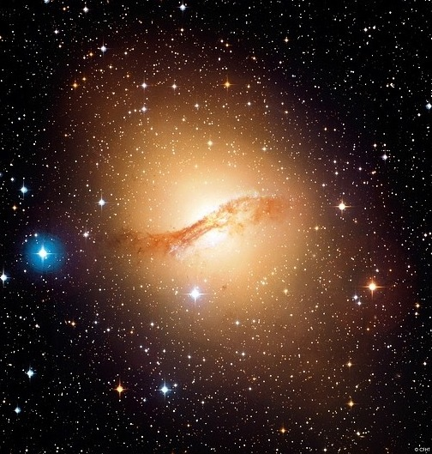
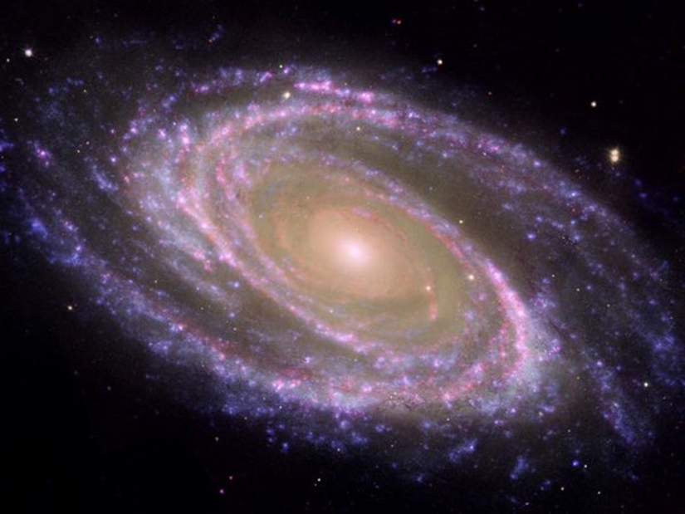
10/10
Take 4 minutes to finish your galaxy flip notes in your notebooks.
If you are done, make sure the following is also complete:
-Planets Forming article
-Star Notes
-EM Spectrum Lab
-Distance Lab
-Galaxy Notes

Slide 3
Expanding Universe
All galaxies are moving away from each other at a measured rate.
This implies that at one point, all galaxies were closer to each other…

Slide 4
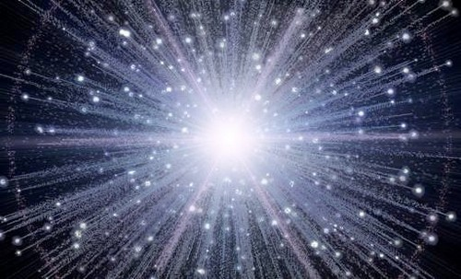
The BIG BANG
Theory that describes the early development of the universe as starting with an enormous explosion about 14-15 billion years ago.
Since the Big bang, the universe has been expanding rapidly.

Slide 5
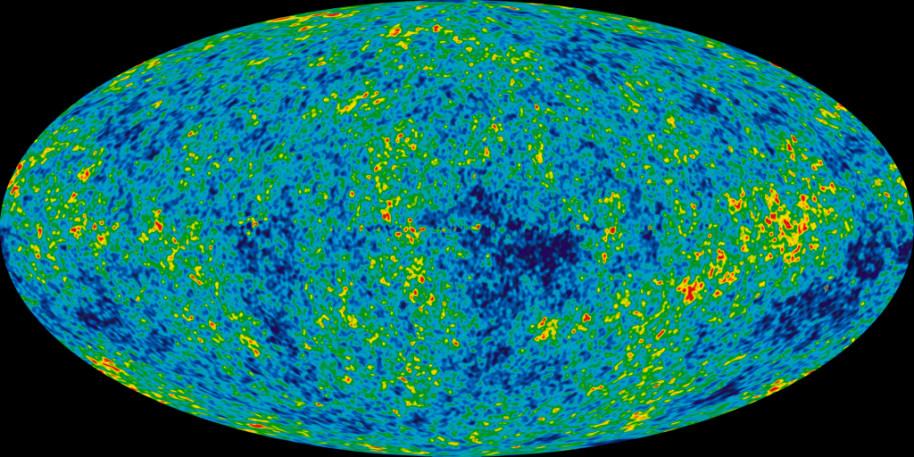

Slide 6
The CMB Background: Cosmic Microwave Background, heat left over from the Big Bang

Slide 7
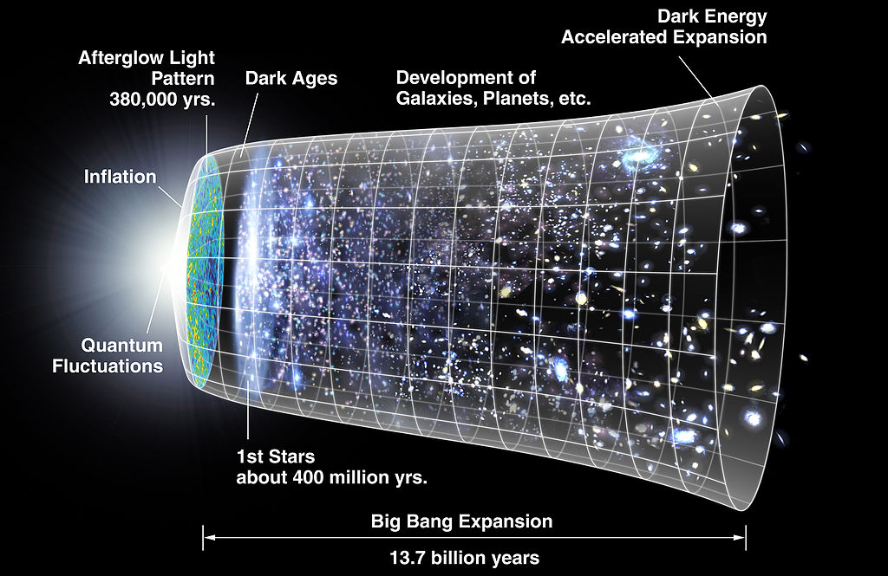

Slide 8
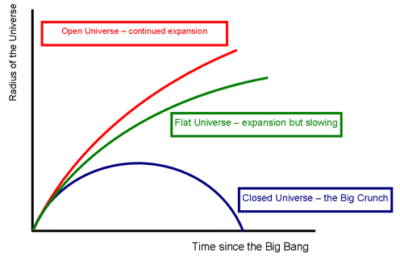
Fate of our Universe
Red:
low mass
Blue:
high mass
The fate of the universe depends on its total mass.

Slide 9

The Big Bang occurs, creating all universe energy.
Elements are formed from energy.
10 billion years ago
15 billion years ago
Elements collect into gas clouds that become galaxies. Galaxies continue to expand away from each other.
Nebulas collapse to become stars.
Large mass stars explode (Supernova) to become heavier elements.
Present conditions in the universe.
Gas and dust around stars collect to become planets (Solar Systems).
5 billion years ago

Slide 10
Controversies of the Big Bang
Scientists can observe all information and evidence of the Big Bang, up until the second before it occurred (What was there BEFORE the Big Bang)
It violates the first law of thermodynamics, which says you can't create or destroy matter or energy.
The early inflationary period of the big bang appears to violate the rule that nothing can travel faster than the speed of light.

Slide 12
Big Bang Summary
P1
Summarize, in your own words;
  What is the Big Bang Theory?
  What events occurred after the Big Bang event?
  What evidence supports the Big Bang Theory?
  What evidence rejects the Big Bang Theory?
  What do you believe about the Big Bang Theory (do you support or reject this theory). If you support, explain what evidence you find most strongly supports the theory. If you reject, what evidence would you need to have in order to support the Big Bang Theory?
P2

Slide 13
http://www.popsci.com/science/article/2013-08/sun-destroying-earth-infographic

